Slide 1
The Need to Develop Maritime Infrastructure In the U.S. Arctic
Presentation by Jay Sterne
HSRP Special Session – Addressing Arctic Challenges
August 30, 2018
Juneau, Alaska

Slide 2
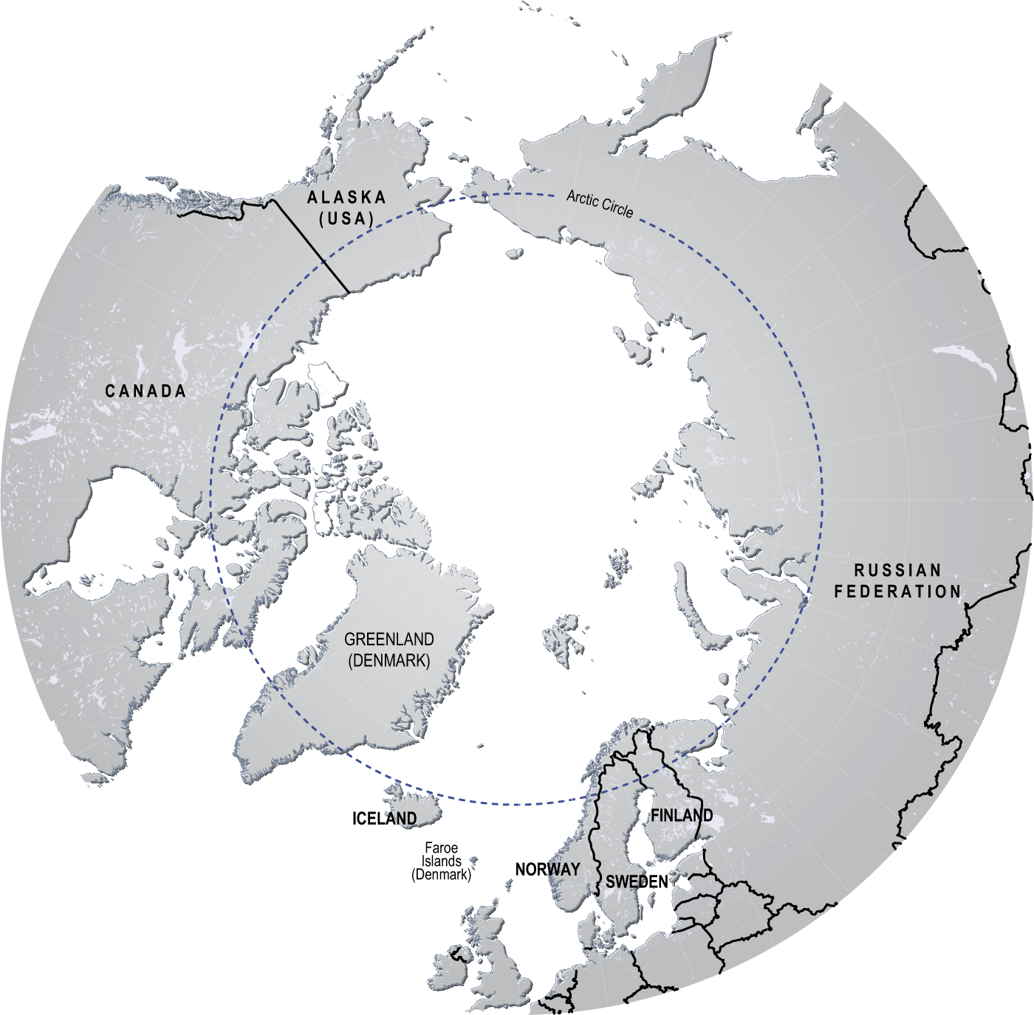
Why do we need to develop maritime infrastructure in the U.S. Arctic?
Support the people and communities in the region
Address increasing maritime traffic
Respond to growing strategic interest in the region
Develop the significant natural resource potential
Prepare for the unique challenges presented by the Arctic marine environment

Slide 3
Balancing Seemingly Competing Interests
Principle 1 of the 1992 Rio Declaration on Environment and Development states:
Human beings are at the centre of concerns for sustainable development. They are entitled to a healthy and productive life in harmony with nature.

Slide 4
Core issues to address
Viability of Arctic communities
Subsistence hunting and fishing
Commercial fishing
Regional marine transportation
Regional fuel distribution
Onshore resource development
Offshore resource development
Tourism
National and Homeland Security missions
Stabilizing presence in the region
Search & Rescue
Oil Spill Response
Protection of the Arctic marine environment
International transits
Development outside U.S. jurisdiction

Slide 5
Drivers for policy in the U.S. Arctic
Congress
Executive Branch
NOAA
USCG
DOI
USN
USACE
State of Alaska
Alaska Native Organizations
Regional and local governments

Slide 6
NOAA – Hydrographic Charting
NOAA’s #1 priority should be completion of modern hydrographic charts for navigationally significant areas in the U.S. Arctic
The 2015 MV Fennica incident in Dutch harbor underscores the need for updated charts even in heavily trafficked areas
The substantial charting backlog in the Arctic is compounded by receding sea-ice and the opening up of new areas for maritime activities
This should be an “all of the above” effort to achieve this goal
NOAA ships, private sector vessels, other federal vessels of opportunity, and outside source data
Coastal mapping should also be incorporated as an integral element to support safe navigation and shore-based activities

Slide 7
NOAA/AOOS – Ocean Data “Infrastructure”
NOAA and AOOS are central to providing timely and accurate data for maritime stakeholders and coastal communities
Sea ice conditions
Weather developments
Marine ecosystem changes
This information helps
Improve safe marine operations, including subsistence hunting and fishing
Reduce coastal hazard risks
Enhance understanding of marine ecosystem changes

Slide 8
Shore-based Infrastructure – USACE
Army Corps’ authority under the WRDA Remote and Subsistence Harbor Provision facilitates port and harbor development in the U.S. Arctic
RSH authority allows the Corps to include non-economic factors in the study and design of projects in the region
(1) Public health and safety of the local community and communities that are located
in the region to be served by the project and that will rely on the project, including access to
facilities designed to protect public health and safety;
(2) Access to natural resources for subsistence purposes;
(3) Local and regional economic opportunities;
(4) Welfare of the regional population to be served by the project; and
(5) Social and cultural value to the local community and communities that are
located in the region to be served by the project and that will rely on the project.

Slide 9
Arctic Deep Draft Port
The Army Corps is proceeding with the feasibility study of an Arctic Deep Draft Port in Nome.
2016 WIIN Act requires that the Army Corps consult with DOD and the Coast Guard to “identify national security benefits associated with an Arctic deep draft port” authorizes the Corps to consider such benefits in determining whether an Arctic deep draft port is feasible.’’

Slide 10
DOD Strategic Arctic Port
The FY17 NDAA requires the Secretary of Defense, in consultation with the Joint Chiefs, USCG, USACE and MARAD to establish criteria for the designation of DOD Arctic Strategic Arctic Ports. Key criteria include:
Ability to accommodate an Arleigh Burke class destroyer, USCG national security cutter and a heavy polar ice breaker
Space for equipment and fuel storage, technological infrastructure, and civil infrastructure to support military and civilian operations, including— aerospace warning; maritime surface and subsurface warning; maritime control and defense; maritime domain awareness; homeland defense; defense support to civil authorities; humanitarian relief; search and rescue; disaster relief; oil spill response; medical stabilization and evacuation; and meteorological measurements and forecasting
Proximity and road access to an airport designated as a commercial service airport by the FAA that is capable of supporting military and civilian aircraft

Slide 11
Shore-based Infrastructure – Port Reception Facilities
With the IMO Polar Code’s entry into force in 2017, member states (including the U.S) are committed to establishing adequate port reception facilities in the Arctic
Options to establish facilities in the U.S. are limited
Federal, state, regional and local stakeholders should work together to accelerate to construct port facilities that can accommodate U.S. vessels as well as international traffic
Minimizing operational discharges helps achieve the goals of
Protecting the Arctic marine environment for subsistence hunting and fishing
Enhancing maritime operations by extending vessel duration in the region
Port reception facilities also represent a potential source of revenue that can help support the development of maritime infrastructure

Slide 12
Community Shore-based Infrastructure
In addition to traditional infrastructure such as ports and harbors, existing communities in the region provide
Airports
Hospitals
Communications
Utility infrastructure
Housing

Slide 13
Other Factors – Conclusion
The eNGO community has targeted the U.S. Arctic and is marketing it as a non-development region
This level of eco-imperialism fails to acknowledge and respect the needs and goals of the people and communities living there
Alaska should not be turned into a “snow globe”
While the challenges are many, the opportunity exists to chart a successful path forward to achieve sustainable development in the U.S. Arctic

